Slide 1

ARTIFICIAL INTELLIGENCE

Slide 2

ARTIFICIAL INTELLIGENCE INTRODUCTION
AI Applications
Intelligent Agents
What is AI ?
Agent Environments
Problem Formulation

Slide 3
Course objectives
To introduce AI and key paradigms of AI
Understand core techniques and algorithms of AI: Deep Learning, Machine Learning, Natural Language Processing, Reinforcement Learning, Q-learning, Intelligent Agents, Various Search Algorithms
Understand the basic of knowledge presentation
Gain knowledge of problem solving techniques
How to build an intelligent system
Notes:
The objective of this course is Introduce to field of AI and key paradigms, core techniques and algm of AI
Understand the basic of knowledge presentation, knowledge of problem solving techniques and learning methods in AI. How it can be used to solve a problem and build an intelligent system. Also analyse strengths and weeknesses in solving problems of engineering world. How to develpo intelligent system to concrete computational problems. See different components of intelligence and Ways of solving problem and. Appreciate Role of natural lang processing, computer vision depending on characterstics of problem, build expert system for diagnostics
Look at some of intelligent system definition of AI

Slide 4
Text books
Artificial Intelligence A modern Approach, 3rd edition, Stuart Russel and Peter Norwig
Artificial intelligence : structures and strategies for complex problem, 6th Edition, Luger, George F, Pearson Education, 2009
Master Machine Learning Algorithms, Edition, v1.12, Jason Brownlee, eBook, 2017
Artificial Intelligence, Patrick H. Winston, 3rd edition, Pearson Education, 1992

Slide 5

AI Applications
A glimpse into the future

Slide 6
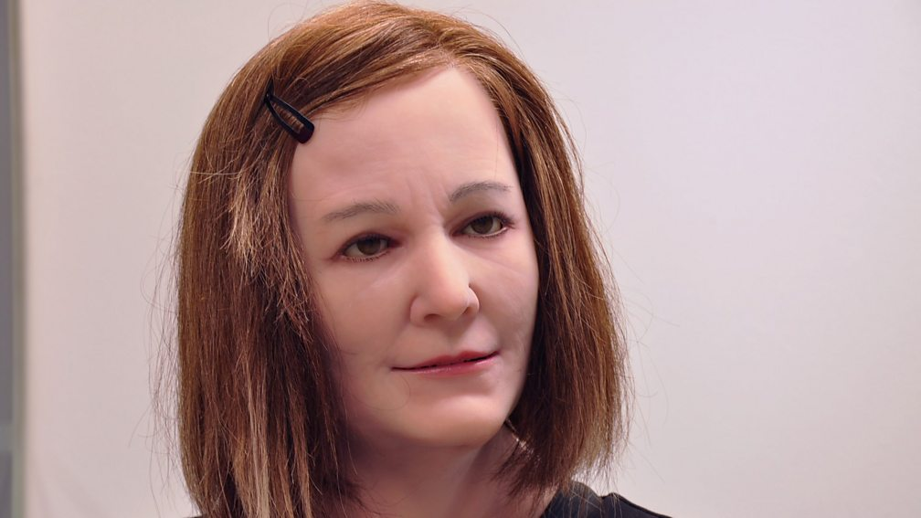
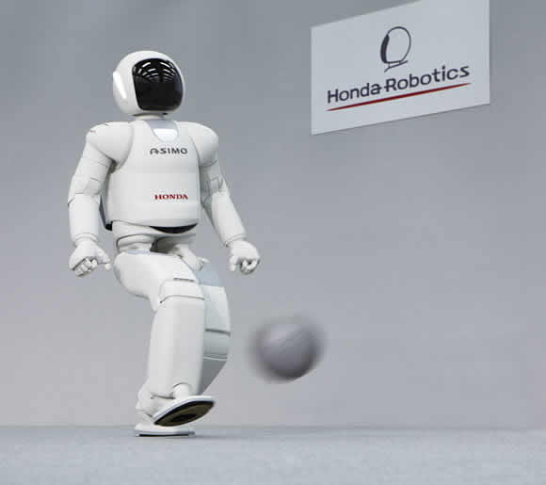
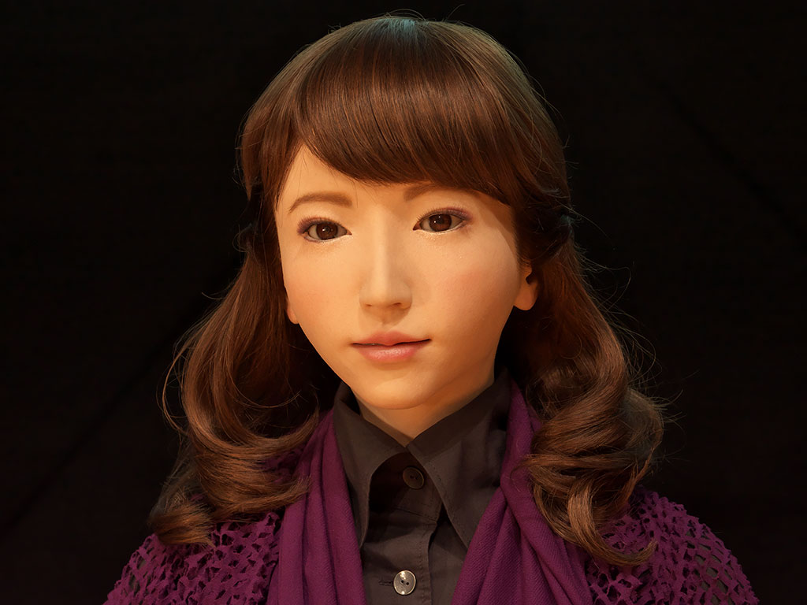
HUMANOID ROBOTS
NADINE
ASIMO
ERICA
https://www.engineeredarts.co.uk/robot/ameca/
SARA Robot
Notes:
Sophia

Slide 7
Nadine: A humanoid social robot modelled after Prof. Nadia Thalmann from NTU Singapore (2013)
Natural skin, realistic hands
Returns a greeting, makes eye contact, and can remember all the conversations had with it.
It is able to answer questions autonomously in several languages,
Simulate emotions both in gestures and facially, depending on the content of the interaction with the user.
Nadine can recognise persons it has previously seen, and engage in flowing conversation.
Nadine has been programmed with a "personality", in that its demeanour can change according to what is said to it.
Nadine has a total of 27 degrees of freedom for facial expressions and upper body movements.
With persons it has previously encountered, it remembers facts and events related to each person.
It can assist people with special needs by reading stories, showing images, put on Skype sessions, send emails, and communicate with other members of the family.
It can play the role of a receptionist in an office or be dedicated to be a personal coach

Slide 8
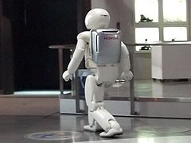
Asimo: A humanoid robot (Honda 2000-2018)
ASIMO

Slide 9
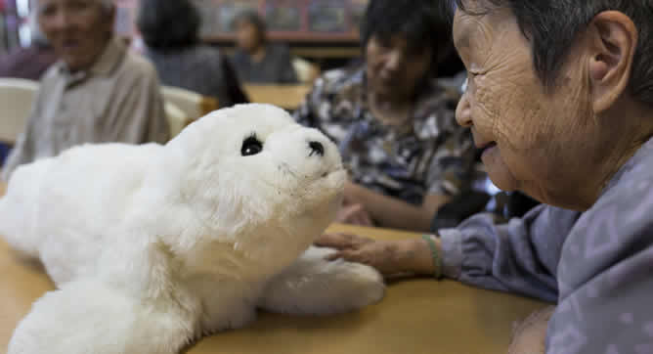

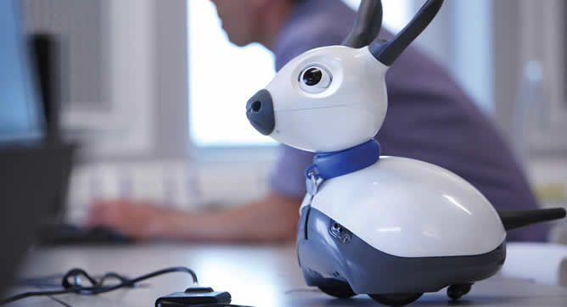
NON-HUMANOID Robots
PARO
AIBO
MIRO
Notes:
Paro: Advanced interactive therapeutic robot designed to stimulate patients with Dementia, Alzheimer's, and other cognition disorders
AIBO is a series of robotic dogs designed and manufactured by Sony
MiRo is a fully programmable autonomous biomimetic robot for researchers, educators, developers and healthcare professionals. With six senses, eight degrees of freedom, an innovative brain-inspired operating system and a simulation software package, MiRo is a flexible platform suited for developing companion robots

Slide 10
IS ai only about Robots?
HDFC Bank has developed an AI-based chatbot called EVA (Electronic Virtual Assistant), built by Bengaluru-based Senseforth AI Research.
Apple's personal assistant, Siri.
Amazon’s Alexa
Tesla Vehicles
Google Maps Vs Google WAZE
Ride Sharing apps like Uber, Lyft
Jarvis by Facebook
Email categorization by Gmail
Photo recognition apps
Face.com Photo Finder and Photo Tagger (now acquired by FB)
DeepText AI Engine by FB (near human accuracy, 20 langauges, 1000s posts/sec)
Notes:
Real Life: AI powered predictions of traffic blocks, analyse speed of movement of traffic(acquired Google WAZE: for suggesting fastest route),
ride sharing apps like Uber how determine prize of ride and minimize wait time, match copassenger to avoid detour,
Jarvis-for windows vista n xp is a context-aware s/w prgm that recognizes your voice and executes command,
Gmail-smart email categorization into primary, social, and promotion,
facebook instantly identify which of your friends is in the photo using facial-recognition
startups like Face.com, now acquired by fb, which developed 2 apps : photo finder and photo tagger, personalize your newsfeed ,
DeepText-AI engine by fb: to understand the sentiment and meaning behind text on social network (near human accuracy, 20 langauges, 1000s posts/sec)
Diff between Google maps (data based, available offline, for walking, driving, biking, public transport) and WAZE (community based, for cars, requires data collection)

Slide 11
Some domains where Ai is infused with
Steering a driver-less car, AI autopilots for commercial flights
Spam Filters
Beating Gary Kasparov in a chess match
Understanding language
Healthcare: Robotic assistants in surgery, CAD
Automated customer support: chatbots
Personalized shopping experience
Finance: Stock brokerage prediction
Travel and navigation
Social Media
Smart home devices
Creative arts: watson BEAT
Security and surveillance

Slide 12
AI problems
Playing chess
Proving mathematical theorems
Writing poetry
Driving a car on a crowded street
Diagnosing diseases

Slide 13

Introduction to AI
How to define AI

Slide 14
WHAT IS ARTIFICIAL INTELLIGENCE?
What is intelligence?
What is thinking
What is a machine? Is computer a machine?
Are humans intelligent?
Can a machines think? If yes, are we machines?

Slide 15
WHAT IS ARTIFICIAL INTELLIGENCE?
Artificial Intelligence is a branch of computer science by which we can create intelligent machines which can behave like a human, think like humans, and able to make decisions​
Artificial Intelligence is the study of systems that​
AI a term coined by McCortey
Think Humanly | Think Rationally
Acting/behaving Humanly | Acting/behaving Rationally

Slide 16
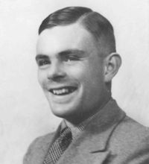
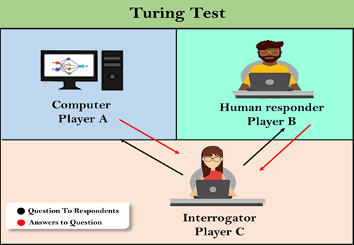
Acting humanly: Turing Test
Human beings are intelligent
To be called intelligent, a machine must produce responses that are indistinguishable from those of a human
Alan Turing
If interrogator cannot reliably distinguish human from computer then computer possess intelligence.
Notes:
Alan Turing : Father of AI has given the operational definition of intelligence. A human interrogator posts some written questions to Player B and C. A Player B and C process the question and submit the answers in textual format to A. From the answers interrogator has to estimate whether it’s a human or computer. Computer tries to convince investigator that it’s a human being.

Slide 17
AI Techniques: REQUIRED Capabilities to ACT humanly(turing test)
Natural Language Processing: Enabling the computer to communicate successfully in English
Knowledge Presentation: Storing what the computer knows or hear
Automated Reasoning: Using the stored information to answer questions and to draw new conclusions
Machine Learning: Adapting to new circumstances and to detect and extrapolate patterns
Computer Vision: To perceive objects
Robotics: To manipulate objects and move about.

Slide 18
Acting humanly: Turing Test
The computer would need to possess the following capabilities:
natural language processing to enable it to communicate successfully in English (or some other human language);
knowledge representation to store information provided before or during the interrogation;
automated reasoning to use the stored information to answer questions and to draw new conclusions;
machine learning to adapt to new circumstances and to detect and extrapolate patterns.
The so-called total Turing Test includes a video signal so that the interrogator can test the subject's perceptual abilities, as well as the opportunity for the interrogator to pass physical objects "through the hatch.“
To pass the total Turing Test, the computer will need
COMPUTER VISION computer vision to perceive objects, and
ROBOTICS robotics to move them about.
The issue of acting like a human comes up primarily when AI programs have to interact with people
Notes:
Alan Turing : Father of AI has given the operational definition of intelligence. A human interrogator posts some written questions to Player B and C. A Player B and C process the question and submit the answers in textual format to A. From the answers interrogator has to estimate whether it’s a human or computer. Computer tries to convince investigator that it’s a human being.

Slide 19
Think Humanly: cognitive modeling approach
To get inside the actual workings of human minds
Three ways to get inside the mind:
Introspection: Trying to catch our own thoughts as they go by
Psychological Experiments: observing a person in action
Brain Imaging: observing the brain in action
The interdisciplinary field of cognitive science brings together computer models from AI and experimental techniques from psychology to construct precise and testable theories of the human mind.
Notes:
Cognitive science: s/m that acts like human and acts rationally
we must have some way of determining how humans think. We need to get inside the actual workings of human minds.

Slide 20
Thinking rationally: The laws of thought approach
Greek philosopher Aristotle was one of the first to attempt to codify "right thinking," that is, irrefutable reasoning processes. His famous syllogisms provided patterns for argument structures that always gave correct conclusions given correct premises.
For example, "Socrates is a man; all men are mortal; therefore Socrates is mortal."
These laws of thought were supposed to govern the operation of the mind, and initiated the field of logic.
There are two main obstacles to this approach. First, it is not easy to take informal knowledge and state it in the formal terms required by logical notation. Second, there is a big difference between being able to solve a problem "in principle" and doing so in practice.
Even problems with just a few dozen facts can exhaust the computational resources of any computer unless it has some guidance as to which reasoning steps to try first.

Slide 21

Act Rationally : The rational Agent Approach

Slide 22
AGENTS
An agent is just something that acts.
Agents can be classified according to the environment in which they are like Intelligent Agents, Human Agent, Robotic agent, Biological Agents, Software/computer Agents, Hardware Agents, Interface Agents, Mobile Agents, Reactive Agents, Information Agents, Distributed Artificial Intelligence Agents DAI …
Computer Agents does:
operate autonomously
perceive their environment
persist over a prolonged time period
adapt to change
create and pursue goals

Slide 23
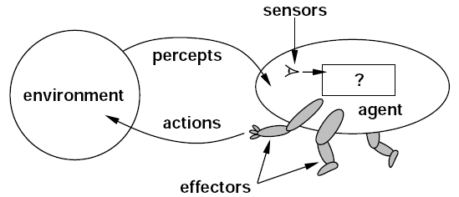
ai agents
An agent is anything that can be viewed as perceiving its environment through sensors and acting upon that environment through actuators - (Artificial Intelligence: A Modern Approach by Stuart Russell and Peter Norvig)
Intelligent Agent must
Must sense
Must act/react
Must autonomous (to some extend)
Must rational

Slide 24
AI AGENT COMPONENTS
Sensors: An agent perceives its environment through sensors. Eg: cameras, infrared range finders
Actuators: Agent can change the environment through actuators/ effectors Eg: Motors
Percept: The complete set of inputs at a given time for an agent is called a percept
Percept sequence: The complete history of everything the agent has perceived
Agent function(agent’s behaviour) maps from percept histories to actions: [f: p* → A]
Agent program runs on the physical architecture to produce f . It is a concrete implementation
Action: An operation involving an actuator is called an action

Slide 25

Vacuum-Cleaner World
Percepts: location and contents,
e.g., [A, dirty]
Actions: Left, Right, Suck, NoOp
Agents Function: look-up table

Slide 26

A Simple Agent Function
Percept sequence | Action
[A, Clean] | Right
[A, Dirty] | Suck
[B, Clean] | Left
[B, Dirty] | Suck
[A, Clean], [A, Clean] | Right
[A, Clean], [A, Dirty] | Suck
…
[A, Clean], [A, Clean], [A, Clean] | Right
[A, Clean], [A, Clean], [A, Dirty] | Suck
…

Slide 27
Properties of AGENT
Rationality
Autonomy
Reactivity.
Notes:
An agent should strive to "do the right thing", based on what:
it can perceive and
the actions it can perform.
The right action is the one that will cause the agent to be most successful

Slide 28
Rationality
An agent should "do the right thing", based on what it can perceive and the actions it can perform. The right action is the one that will cause the agent to be most successful
A rational agent always selects an action based on the percept sequence it has received so as to maximize its (expected) performance measure given the percept it has received and the knowledge possess by it.
Definition Ideal Rational Agent: For each possible percept sequence, a rational agent should select an action that is expected to maximize its performance measure, given the evidence provided by the percept sequence and whatever built-in knowledge the agent has.
Notes:
A rational agent is one that acts so as to achieve the best outcome or, when there is uncertainty, the best expected outcome.
Road crossing…. No vehicles…crossed…something falls from above…is agent not rational?
It has to be ability to act to receive the percept (look left right on road) and then take actions (walk)
Say, if an agent does not look both ways before crossing a busy road, then its percept sequence will not tell it that there is a large truck approaching at high speed.
The definition seems to say that it would be OK for it to cross the road. In fact, this interpretation is wrong on two counts. First, it would not be rational
to cross the road: the risk of crossing without looking is too great. Second, an ideal rational agent would have chosen the "looking" action before stepping into the street, because looking helps maximize the expected performance. Doing actions in order to obtain useful information is an important part of rationality
Consider a clock. It can be thought of as just an inanimate object, or it can be thought of as a simple agent. As an agent, most clocks always do the right action: moving their hands (or displaying digits) in the proper fashion. Clocks are a kind of degenerate agent in that their percept sequence is empty; no matter what happens outside, the clock's action should be unaffected. Well, this is not quite true. If the clock and its owner take a trip from California to Australia, the right thing for the clock to do would be to turn itself back six hours. We do not get upset at our clocks for failing to do this because we realize that they are acting rationally, given their lack of perceptual equipment.

Slide 29
RATIONALITY
Rational is different from omniscience
Percepts may not supply all relevant information. We can behave rationally even when faced with incomplete information.
E.g., in card game, don’t know cards of others.
Rational is different from being perfect
Rationality maximizes expected outcome while perfection maximizes actual outcome.

Slide 30
Autonomy
DEFINITION: The autonomy of an agent is the extent to which its behavior is determined by its own experience(in dynamic unpredictable environments ), rather than knowledge of designer.
Agents can perform actions in order to modify future percepts so as to obtain useful information: information gathering, exploration.
Extremes
No autonomy – ignores environment/data
Complete autonomy – must act randomly/no program
Example: baby learning to crawl
Ideal
Idesign agents to have some autonomy
Possibly become more autonomous with experience

Slide 31
Reactivity
DEFINITION: A reactive system is one that maintains an ongoing interaction with its environment, and responds to changes that occur in it (in time for the response to be useful)
Ways to achieve reactivity
Reactive architectures
[Situation – Action] rules
Layered, behaviour-based architectures
Deliberative architectures
Symbolic world model, long-term goals
Reasoning, planning
Hybrid architectures
Reactive layer + deliberative layer
Notes:
(ex fuzzy inference systems)
In order to define reactivity we shall first define the notion of logical agent and consider what are Knowledge Based Agents. Concept of Logical Agent.“An agent that can form representations of the world,use a process of inference to derive new references of the worldand use these new representatives to decide what to do.”
Knowledge Based agents are flexible i.e they can adapt to changes in the environment and update the relevant knowledge. The central component of the KBA is its knowledge base which consists of a set of sentences expressed in a special language called the knowledge representation language. It represents some assertion about the world. Two tasks namely TELL and ASK allow sentences to be added and retrieved from the Knowledge base. New sentences can be derived from the older ones using a process called inference.

Slide 32
PEAS ANALYSIS
Must first specify the setting for intelligent agent design
Agents can be described by their PEAS.
A rational agent maximizes the performance measure for their PEAS

Slide 33
PEAS
Specifying the task environment is always the first step in designing agent
PEAS:
Performance
Environment
Actuators
Sensors
PAGE Description
Percepts
Actions
Goals
Environment
Notes:
Its also called as PAGE representation/Descriptions
Percepts Actions Goals Environment
Sensors, Actuators Performance_Measures Environment

Slide 34
PERFORMANCE MEASURES
Performance measure: An objective criterion for success of an agent's behavior. The performance measure depends on the agent function.
Performance measures of a vacuum-cleaner agent: amount of dirt cleaned up, amount of time taken, amount of electricity consumed, level of noise generated, etc.
Performance measures self-driving car: time to reach destination (minimize), safety, predictability of behavior for other agents, reliability, etc.
Performance measure of game-playing agent: win/loss percentage (maximize), robustness, unpredictability (to “confuse” opponent), etc.

Slide 35
The Environment
What all do we need to specify?
The action space
The percept space
The environment as a string of mappings from the action space to the percept space

Slide 36
TAXI DRIVER EXAMPLE
Performance Measure | Environment | Actuators | Sensors
safe, fast, legal, comfortable trip, maximize profits | roads, other traffic, pedestrians, customers | steering, accelerator, brake, signal, horn, display | camera, sonar, speedometer, GPS, odometer, engine sensors, keyboard, accelerometer

Slide 37
Medical diagnosis system
Performance Measure | Environment | Actuators | Sensors
Healthy patient, minimize costs, lawsuits | Patient, hospital, staff | Screen display (questions, tests, diagnoses, treatments, referrals) | Keyboard (entry of symptoms, findings, patient's answers)

Slide 38
Part-picking robot
Performance Measure | Environment | Actuators | Sensors
Percentage of parts in correct bins | Conveyor belt with parts, bins | Jointed arm and hand | Camera, joint angle sensors

Slide 39
Interactive English tutor
Performance Measure | Environment | Actuators | Sensors
Maximize student's score on test | Set of students | Screen display (exercises, suggestions, corrections) | Keyboard

Slide 40
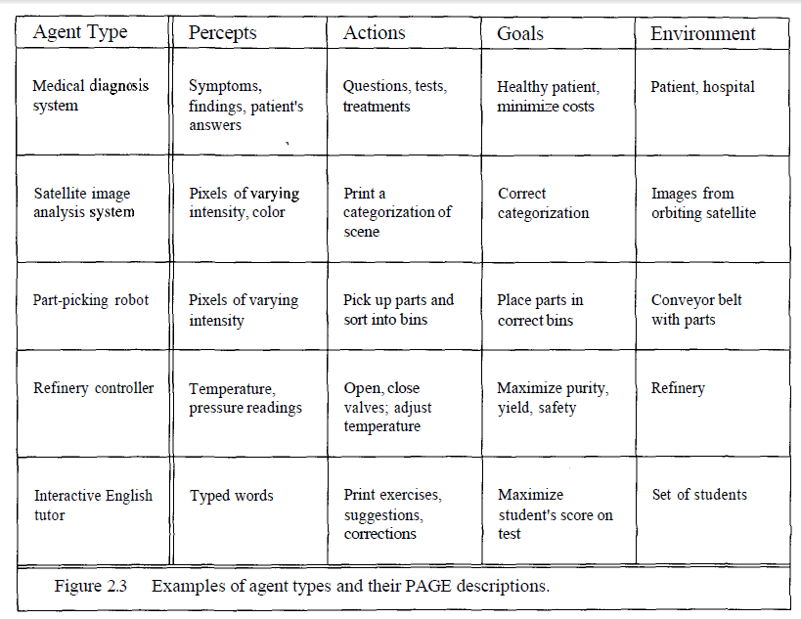
Examples PAGE descriptions

Slide 41
Structure of Intelligent Agents

Slide 42
The job of AI is to design the agent program: a function that implements the agent mapping from percepts to actions. We assume this program will run on some sort of ARCHITECTURE computing device, which we will call the architecture. The architecture might be a plain computer, or it might include special-purpose hardware for certain tasks, such as processing camera images or filtering audio input.
Agent’s structure can be viewed as:
Agent = Architecture + Agent Program
Architecture = the machinery that an agent executes on.
Agent Program = an implementation of an agent function. (….our focus )

Slide 43
AI Agent environment

Slide 44
Agent Environment Types
Fully Observable(vs. partially observable)
Deterministic(vs. stochastic)
Episodic (vs. sequential)
Static Environment (vs. dynamic)
Discrete(vs.continuous)
Single Agent(vs. multiagent)

Slide 45
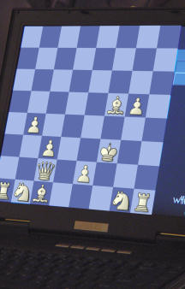
Environment types
Fully observable (vs. partially observable)(Accessible vs. inaccessible): An agent's sensors give it access to the complete state of the environment at each point in time. An accessible environment is one in which the agent can obtain complete, accurate, up-to-date information about the environment’s state. Most moderately complex environments (for example, the everyday physical world and the Internet) are inaccessible. The more accessible an environment is, the simpler it is to build agents to operate in it
Deterministic (vs. stochastic): The next state of the environment is completely determined by the current state and the action executed by the agent(agent’s action uniquely determines the outcome). (If the environment is deterministic except for the actions of other agents, then the environment is strategic) A deterministic environment is one in which the next state of the environment is completely determined by the current state and the action executed by the agent. The physical world can to all intents and purposes be regarded as non-deterministic. Non-deterministic environments present greater problems for the agent designer
Notes:
In stochastic, certain amount of randomness is involved.

Slide 46
Environment types
Episodic (vs. sequential): The agent's experience is divided into atomic "episodes" (each episode consists of the agent perceiving and then performing a single action), and the choice of action in each episode depends only on the episode itself. In an episodic environment, the performance of an agent is dependent on a number of discrete episodes, with no link between the performance of an agent in different scenarios • Episodic environments are simpler from the agent developer’s perspective because the agent can decide what action to perform based only on the current episode — it need not reason about the interactions between this and future episodes
Static (vs. dynamic): The environment is unchanged while an agent is deliberating. (The environment is semi-dynamic if the environment itself does not change with the passage of time but the agent's performance score does) A static environment is unchanged while an agent is reflecting. A dynamic environment is one that has other processes operating on it, and which hence changes in ways beyond the agent’s control. Other processes can interfere with the agent’s actions (as in concurrent systems theory). The physical world is a highly dynamic environment
Discrete (vs. continuous): A limited number of distinct, clearly defined percepts and actions. An environment is discrete if there are a fixed, finite number of actions and percepts in it – Ex: chess game. Continuous environments have a certain level of mismatch with computer systems – Ex: taxi driving. Discrete environments could in principle be handled by a kind of “lookup table”
Single agent (vs. multiagent): An agent operating by itself in an environment.

Slide 47
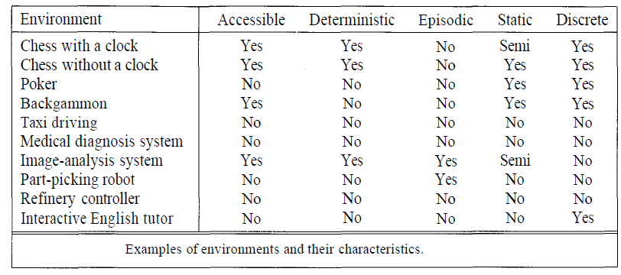
Environment types

Slide 48
Agent types
Four basic types in order of increasing generality:
Simple reflex agents
Reflex agents with state/model(Model based)
Goal-based agents
Utility-based agents
Learning Agents

Slide 49
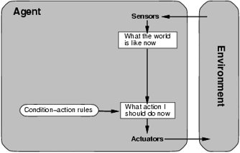
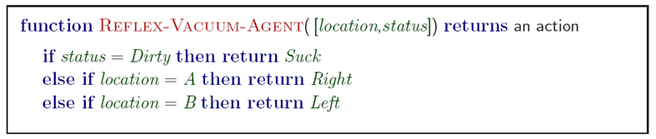
Simple reflex agents
It works by finding a rule whose condition matches the current situation (as defined by the percept) and then doing the action associated with that rule.
if car-in-front-is-braking then initiate-braking
Notes:
if car-in-front-is-bmking then initiate-braking

Slide 50
Simple reflex agents
Simple but very limited intelligence.
Action does not depend on percept history, only on current percept.
Therefore no memory requirements.
Infinite loops
Suppose vacuum cleaner does not observe location. What do you do given location = clean? Left of A or right on B -> infinite loop.
Consider the following more obvious case: from time to time, the driver looks in the rear-view mirror to check on the locations of nearby vehicles.
When the driver is not looking in the mirror, the vehicles in the next lane are invisible (i.e., the states in which they are present and absent are indistinguishable); but in order to decide on a lane-change maneuver, the driver needs to know whether or not they are there.
The problem illustrated by this example arises because the sensors do not provide access to the complete state of the world.
In such cases, the agent may need to maintain some internal state information in order to distinguish between world states that generate the same perceptual input but nonetheless are significantly different. Here, "significantly different" means that different actions are appropriate in the two states.
Notes:
Consider the following more obvious case: from time to time, the driver looks in the rear-view mirror to check on the locations of nearby vehicles. When the driver is not looking in the mirror, the vehicles in the next lane are invisible (i.e., the states in which they are present and absent are indistinguishable); but in order to decide on a lane-change maneuver, the driver needs to know whether or not they are there. The problem illustrated by this example arises because the sensors do not provide access to
the complete state of the world. In such cases, the agent may need to maintain some internal state information in order to distinguish between world states that generate the same perceptual input but nonetheless are significantly different. Here, "significantly different" means that different actions are appropriate in the two states.

Slide 51
Simple reflex agents
Simple but very limited intelligence.
Action does not depend on percept history, only on current percept.
Therefore no memory requirements.
Infinite loops
Suppose vacuum cleaner does not observe location. What do you do given location = clean? Left of A or right on B -> infinite loop.
Fly buzzing around window or light.
Possible Solution: Randomize action.
Thermostat.
Chess – openings, endings
Lookup table (not a good idea in general)
35¹⁰⁰ entries required for the entire game
Notes:
Consider the following more obvious case: from time to time, the driver looks in the rear-view mirror to check on the locations of nearby vehicles. When the driver is not looking in the mirror, the vehicles in the next lane are invisible (i.e., the states in which they are present and absent are indistinguishable); but in order to decide on a lane-change maneuver, the driver needs to know whether or not they are there. The problem illustrated by this example arises because the sensors do not provide access to
the complete state of the world. In such cases, the agent may need to maintain some internal state information in order to distinguish between world states that generate the same perceptual input but nonetheless are significantly different. Here, "significantly different" means that different actions are appropriate in the two states.

Slide 52
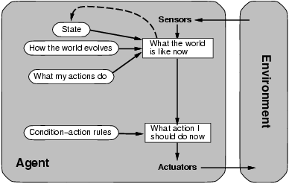
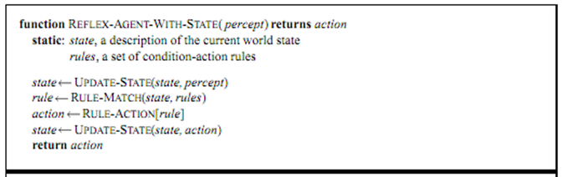
Model-based reflex agents
They use a model of the world to choose their actions. They maintain an internal state.
Model − knowledge about “how the things happen in the world”.
Internal State − It is a representation of unobserved aspects of current state depending on percept history.
Updating the state requires the information about −
How the world evolves.
How the agent’s actions affect the world.

Slide 53
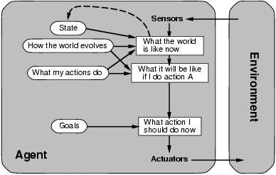
Goal-based agents

Slide 54
Goal Based agents
They choose their actions in order to achieve goals. Goal-based approach is more flexible than reflex agent since the knowledge supporting a decision is explicitly modeled, thereby allowing for modifications.
Goal − It is the description of desirable situations.
At a road junction, the taxi can turn left, right, or go straight on. The right decision depends on where the taxi is trying to get to. In other words, as well as a current state description, the agent needs some sort of goal information, which describes situations that are desirable
The agent program can combine this with information about the results of possible actions (the same information as was used to update internal state in the reflex agent) in order to choose actions that achieve the goal.
Sometimes, this will be simple, when goal satisfaction results immediately from a single action;
sometimes, it will be more tricky, when the agent has to consider long sequences of twists and turns to find a way to achieve the goal. Search and planning are the subfields of AI devoted to finding action sequences that do achieve the agent's goals.

Slide 55
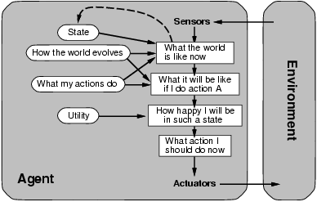
Utility-based agents
Goals alone are not really enough to generate high-quality behavior.
For example, there are many action sequences that will get the taxi to its destination, thereby achieving the goal, but some are quicker, safer, more reliable, or cheaper than others.
Goals just provide a crude distinction between "happy" and "unhappy" states, whereas a more general performance measure should allow a comparison of different world states (or sequences of states) according to exactly how happy they would make the agent if they could be achieved.
Because "happy" does not sound very scientific, the customary terminology is to say that if one world state is preferred to another, then it has higher utility for the agent.
Utility is therefore a function that maps a state onto a real number, which describes the associated degree of happiness.
Notes:
Goals alone are not really enough to generate high-quality behavior. For example, there are many action sequences that will get the taxi to its destination, thereby achieving the goal, but some I are quicker, safer, more reliable, or cheaper than others. Goals just provide a crude distinction between "happy" and "unhappy" states, whereas a more general performance measure should j allow a comparison of different world states (or sequences of states) according to exactly how happy they would make the agent if they could be achieved. Because "happy" does not sound very scientific, the customary terminology is to say that if one world state is preferred to another, then it has higher utility for the agent. Utility is therefore a function that maps a state9 onto a real number, which describes the j associated degree of happiness.

Slide 56
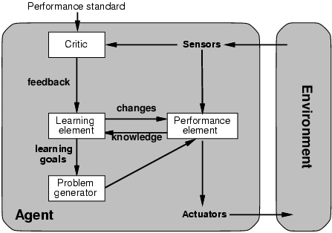
Learning agents
A learning agent in AI is the type of agent which can learn from its past experiences or it has learning capabilities. It starts to act with basic knowledge and then able to act and adapt automatically through learning. A learning agent has mainly four conceptual components, which are:
Learning element :It is responsible for making improvements by learning from the environment
Critic: Learning element takes feedback from critic which describes how well the agent is doing with respect to a fixed performance standard.
Performance element: It is responsible for selecting external action
Problem Generator: This component is responsible for suggesting actions that will lead to new and informative experiences.

Slide 57
Problem Formulation

Slide 58
State Space Representation
Each agent is an abstract representation of the agent’s environment . It is an abstraction that denotes configuration of agent
INITIAL STATE: The description of the starting configuration of the agent
An ACTION/OPERATOR takes the agent from on state to the another state. A state can have number of successor states
A PLAN is sequence of actions
A GOAL is a description of a set of desirable states of the world. Goal states are often specified by a goal test which any goal state must satisfy
PATH COST: path cost→ positive number. Usually path cost = sum of step costs

Slide 59
Problem formulation
Problem formulation means choosing a relevant set of states to consider, and a feasible set of operators for moving from one state to another
Search is the process of imagining sequences of operators applied to the initial state, and checking which sequence reaches the goal state
If you are able to represent the problem in terms of state space representation, you can solve the problem using the search techniques which finds out the set of states and the corresponding actions that will start with initial states s to final state goal G

Slide 60
Problem formulation:
Vacuum Cleaner
Missionaries and cannibals
Cryptarithmatic
N-Queens Problem (8-Queens Problem)
N-Puzzle Problem (N-Puzzle Problem)
Water Jug Problem
MLGC Problem (Man Lion Goat Cabbage)

Slide 61
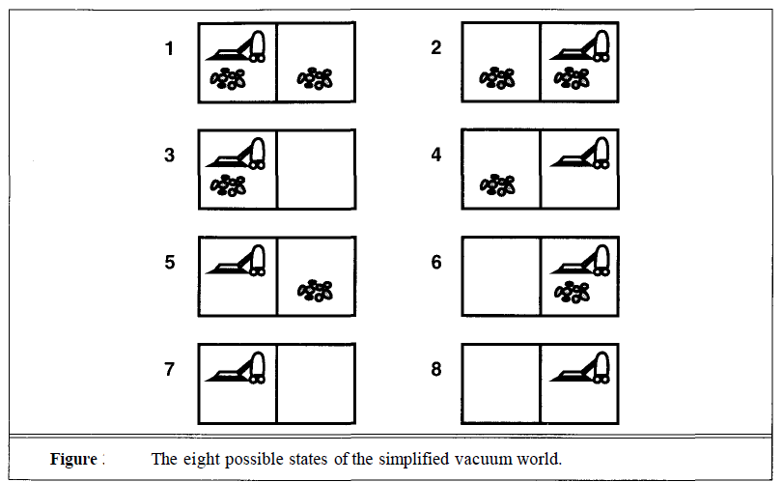
Problem formulation: Vacuum Cleaner
Let the world contain just two locations. Each location may or may not contain dirt, and the agent may be in one location or the other.
There are 8 possible world states
The agent has three possible actions in this version of the vacuum world: Left, Right, and Suck.
Assume, for the moment, that sucking is 100% effective.
The goal is to clean up all the dirt. That is, the goal is equivalent to the state set {7,8}.
Suppose that the agent's sensors give it enough information to tell exactly which state it is in (i.e., the world is accessible); and suppose that it knows exactly what each of its actions does. Then it can calculate exactly which state it will be in after any sequence of actions. For example, if its initial state is 5, then it can calculate that the action sequence [Right,Suck] will get to a goal state. This is the simplest case, which we call a single-state problem.

Slide 62
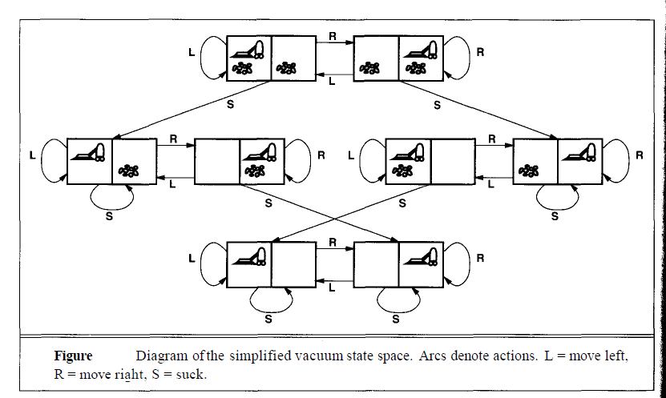
Problem formulation: Vacuum Cleaner

Slide 63

Problem formulation: Missionaries & Cannibals
3 missionaries and 3 cannibals need to cross a river
1 boat that can carry 1 or 2 people
Find a way to get everyone to the other side, without ever leaving the group of missionaries in one place outnumbered by cannibals in that place
Link:
http://www.learn4good.com/games/puzzle/boat.htm
https://www.novelgames.com/en/missionaries/

Slide 64
Problem formulation: Missionaries & Cannibals
Problem Formulation
■ States:
<m, c, b> representing the # of missionaries and the # of cannibals, and the position of the boat
■ Initial state:
<3, 3, 1>
■ Actions:
take 1 missionary, 1 cannibal, 2 missionaries, 2 cannibals, or 1 missionary and 1 cannibal across the river
■ Transition model:
state after an action
■ Goal test:
<0, 0, 0>
■ Path cost:
number of crossing

Slide 65
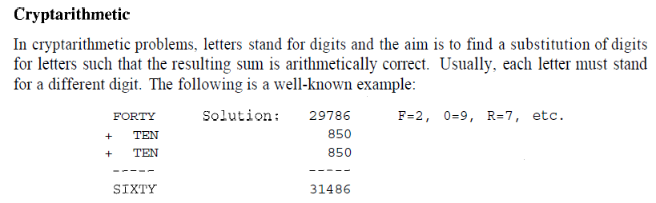
Problem formulation: Cryptarithmatic
Solve:
TO+GO=OUT
SEND+MORE=MONEY
Notes:
No two letters are assigned same value betn 0-9, only one carry fwd, sum of digits must be as per prob
TO+GO=OUT
SEND+MORE=MONEY

Slide 66
Problem formulation: Cryptarithmatic
The following formulation is probably the simplest:
States: a cryptarithmetic puzzle with some letters replaced by digits.
Operators: replace all occurrences of a letter with a digit not already appearing in the puzzle.
Goal test: puzzle contains only digits, and represents a correct sum.
Path cost: zero. All solutions equally valid.

Slide 67

8-Queens Problem
State: 8*8 chessboard (empty, or one queen placed in first col in each row, etc.)
Goal: all Queens on chessboard such that no two queens attack each other
Actions:
Placing one queen in one of the squares
Cost: Can be number of moves

Slide 68
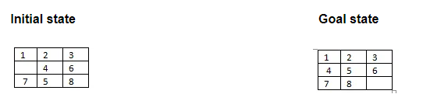
8-Puzzle problem
State: 3*3 pattern of tiles with each tile having a number [1-8] and one tile blank
Actions:
The empty space can only move in four directions (Movement of empty space): Up, Down, Right or Left
The empty space cannot move diagonally and can take only one step at a time.
Cost: Can be number of moves

Slide 69
Water Jug Problem
You are given an m liter jug and a n liter jug. Both the jugs are initially empty. The jugs don’t have markings to allow measuring smaller quantities. You have to use the jugs to measure d liters of water where d is less than n. No limitation of water usage
State: (X, Y) corresponds to a state where X refers to the amount of water in Jug1 and Y refers to the amount of water in Jug2 Goal: Determine the path from the initial state (xi, yi) to the final state (xf, yf), where (xi, yi) is (0, 0) which indicates both Jugs are initially empty and (xf, yf) indicates a state which could be (0, d) or (d, 0).
Actions:
Empty a Jug, Ex. (X, Y)->(0, Y) Empty Jug 1
Fill a Jug, Ex. (0, 0)->(X, 0) Fill Jug 1
Pour water from one jug to the other until one of the jugs is either empty or full, Ex. (X, Y) -> (X-d, Y+d)

Slide 70
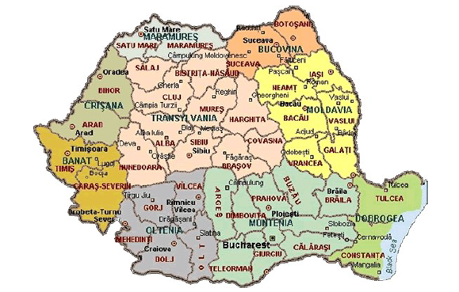
Solving problems by searching
Figure: Map of Romania

Slide 71
Solving problems by searching
Intelligent agents are supposed to act in such a way that the environment goes through a sequence of states that maximizes the performance measure.
In its full generality, this specification is difficult to translate into a successful agent design.
Imagine our agent in the city of Arad, Romania, toward the end of a touring holiday.
The agent has a ticket to fly out of Bucharest the following day. The ticket is nonrefundable, the agent's visa is about to expire, and after tomorrow, there are no seats available for six weeks.
Now the agent's performance measure contains many other factors besides the cost of the ticket and the undesirability of being arrested and deported. For example, it wants to improve its suntan, take in the sights, and so on.

Slide 72
Solving problems by searching
All these factors might suggest any of a vast array of possible actions.
Given the seriousness of the situation, however, it should adopt the goal of driving to Bucharest.
Actions that result in a failure to reach Bucharest on time can be rejected without further consideration.
Goals such as this help organize behavior by limiting the objectives that the agent is trying to achieve.
Goal formulation, based on the current situation, is the first step in problem solving.
Formulating a goal, the agent may wish to decide on some other factors that affect the desirability of different ways of achieving the goal.

Slide 73
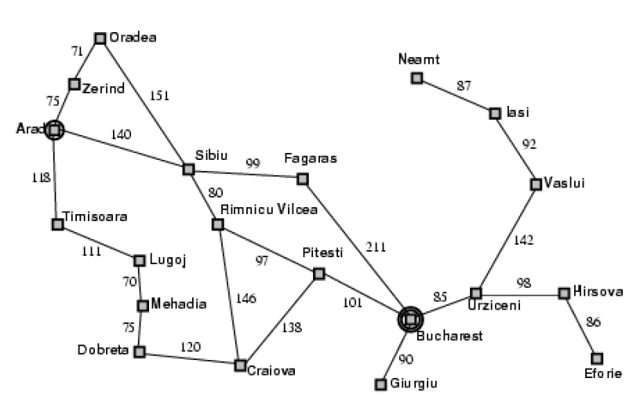
Route-finding problem from Arad to Bucharest
Figure: Romania routes

Slide 74
Solving problems by searching
Problem formulation is the process of deciding what actions and states to consider, and follows goal formulation.
Our agent has now adopted the goal of driving to Bucharest, and is considering which town to drive to from Arad. There are three roads out of Arad, one toward Sibiu, one to Timisoara, and one to Zerind. None of these achieves the goal, so unless the agent is very familiar with the geography of Romania, it will not know which road to follow.
If the agent has no additional knowledge, then it is stuck. The best it can do is choose one of the actions at random.
But suppose the agent has a map of Romania, either on paper or in its memory.

Slide 75
Solving problems by searching
The agent can use this information to consider subsequent stages of a hypothetical journey through each of the three towns, to try to find a journey that eventually gets to Bucharest.
Once it has found a path on the map from Arad to Bucharest, it can achieve its goal; by carrying out the driving actions that correspond to the legs of the journey.
In general, then, an agent with several immediate options of unknown value can decide what to do by first examining ; different possible sequences of actions that lead to states of known value, and then choosing the best one.
This process of looking for such a sequence is called search. A search algorithm takes a problem as input and returns a solution in the form of an action sequence.

Slide 76
Solving problems by searching
Once the solution is found, the actions it recommends can be carried out. This is called the execution phase.
Thus, we have a simple "formulate, search, execute" design for the agent.
After formulating a goal and a problem to solve, the agent calls a search procedure to solve it.
It then uses the solution to guide its actions, doing whatever the solution recommends as the next thing to do, and then removing that step from the sequence.
Once the solution has been executed, the agent will find a new goal.

Slide 77
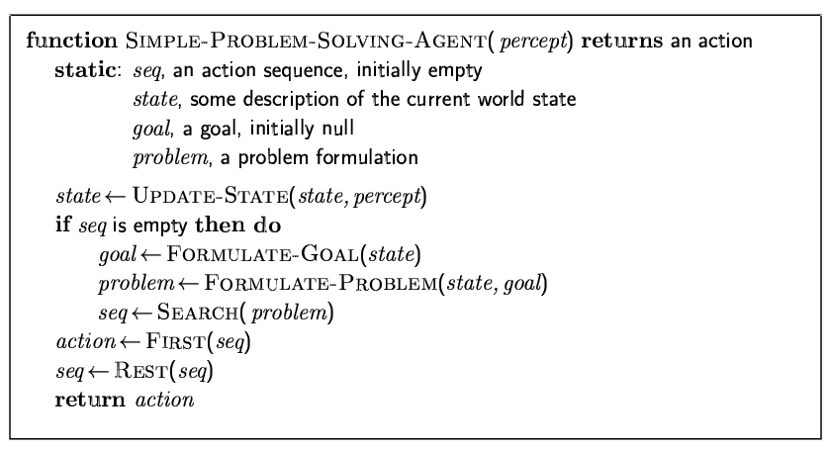
Problem-solving agents
Notes:
We will not discuss the UPDATE-STATE and FORMULATE-GOAL functions further in this chapter. The next two sections describe the process of problem formulation, and then the remainder of the chapter is devoted to various versions of the SEARCH function. The execution phase is usually straightforward for a simple problem-solving agent: RECOMMENDATION just takes the first action in the sequence, and REMAINDER returns the rest.

Slide 78
Generating action sequences: Route-finding problem from Arad to Bucharest
Figure: Romania routes

Slide 79
Generating action sequences
Route-finding problem from Arad to Bucharest
Let initial state, Arad. The first step is to test if this is a goal state. Clearly it is not, but it is important to check so that we can solve trick problems like "starting in Arad, get to Arad."
Because this is not a goal state, we need to consider some other states. This is done by applying the operators to the current state, thereby generating a new set of states. The process is called expanding the state.
In this case, we get three new states, "in Sibiu," "in Timisoara," and "in Zerind," because there is a direct one-step route from Arad to these three cities.
If there were only one possibility, we would just take it and continue. But whenever there are multiple possibilities, we must make a choice about which one to consider further

Slide 80
Generating action sequences
Route-finding problem from Arad to Bucharest contd...
This is the essence of search—choosing one option and putting the others aside for later, in case the first choice does not lead to a solution.
Suppose we choose Zerind. We check to see if it is a goal state (it is not), and then expand it to get "in Arad" and "in Oradea." We can then choose any of these two, or go back and choose Sibiu or Timisoara.
We continue choosing, testing, and expanding until a solution is found, or until there are no more states to be expanded.
The choice of which state to expand first is determined by the search strategy.

Slide 81
Generating action sequences
Route-finding problem from Arad to Bucharest contd...
We can look at search process as building up a search tree that is superimposed over the state space.
The root of the search tree is a search node corresponding to the initial state.
The leaf nodes of the tree correspond to states that do not have successors in the tree, either because they have not been expanded yet, or because they were expanded, but generated the empty set.
At each step, the search algorithm chooses one leaf node to expand.

Slide 82
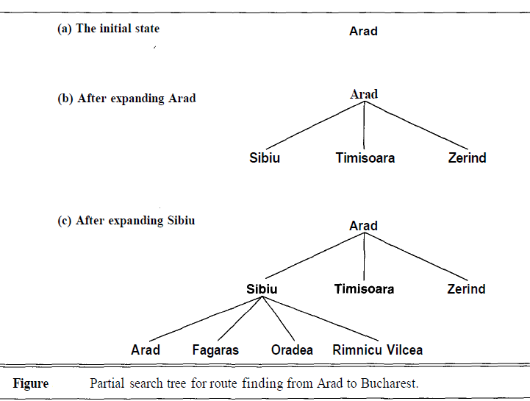
Route-finding problem from Arad to Bucharest: Some expansions

Slide 83
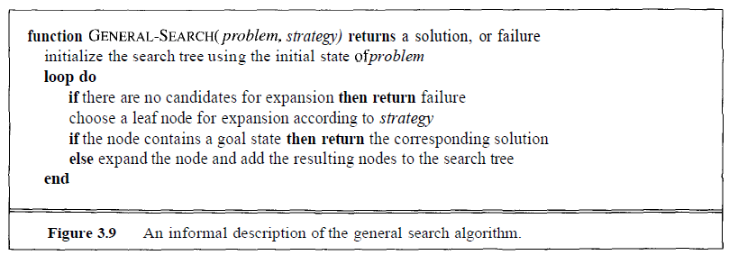
The
general search algorithm
Distinguish between the state space and the search tree.
For the routefinding problem, there are only 20 states in the state space, one for each city.
But there are an infinite number of paths in this state space, so the search tree has an infinite number of nodes.
For example, the branch Arad-Sibiu-Arad continues Arad-Sibiu-Arad-Sibiu-Arad, and so on, indefinitely.
A good search algorithm avoids following such paths.

Slide 84
Data structures for search trees
datatype node
components: STATE, PARENT-NODE, OPERATOR, DEPTH, PATH-COST
We assume a node is a data structure with five components:
the state in the state space to which the node corresponds;
the node in the search tree that generated this node (this is called the parent node);
the operator that was applied to generate the node;
the number of nodes on the path from the root to this node (the depth of the node);
the path cost of the path from the initial state to the node.

Slide 85
Data structures for search trees
Difference between Node and state:
A node is a bookkeeping data structure used to represent the search tree for a particular problem instance as generated by a particular algorithm.
A state represents a configuration (or set of configurations) of the world.
Thus, nodes have depths and parents, whereas states do not.
It is quite possible for two different nodes to contain the same state, if that state is generated via two different sequences of actions.

Slide 86
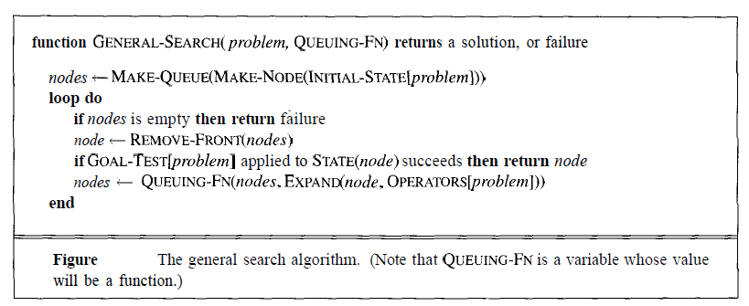
formal version of the general search algorithm

Slide 87
SEARCH STRATEGIES
Search strategies evalution in terms of four criteria:
Completeness: is the strategy guaranteed to find a solution when there is one?
Time complexity: how long does it take to find a solution?
Space complexity: how much memory does it need to perform the search?
Optimality: does the strategy find the highest-quality solution when there are several different solutions?

Slide 88
SEARCH STRATEGIES
Blind Search
Depth First Search
Breadth First Search
Iterative Deepening Search
Bidirectional Search
Informed Search
Constraint Satisfaction
Adversary Search

Slide 89

Thank You

